Slide 1
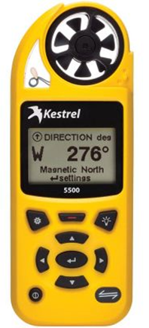
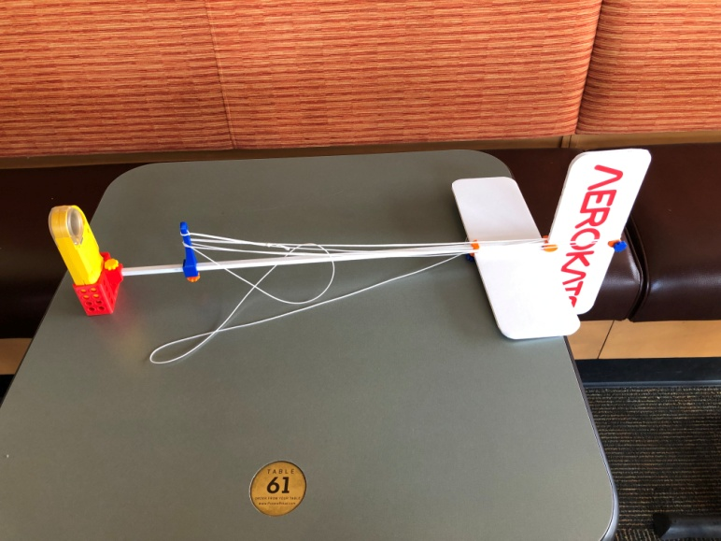
Kite Mounted With Weather Sensor Pod
Experiments were carried out before center shutdown due to COVID
Kites with attached sensor pods would collect weather data at an altitude of more than 500 ft.
Sensor is from Kestrel that could provide up to 40 various weather data components
The sensor has built-in blue tooth capability.
Currently, this technology is being considered for collecting weather data for UAV navigation
Kite
Sensor Pod
Test flying carried out on 10-8-19.
Sensor Pod
https://kestrelinstruments.com/kestrel-5500-weather-meter?gclid=Cj0KCQiAvvKBBhCXARIsACTePW_ijgHc76zW8lY6YP6_ODHENiF99X6fxylPuV6xndoM_P1q1qMR8BEaAl2DEALw_wcB

Slide 2
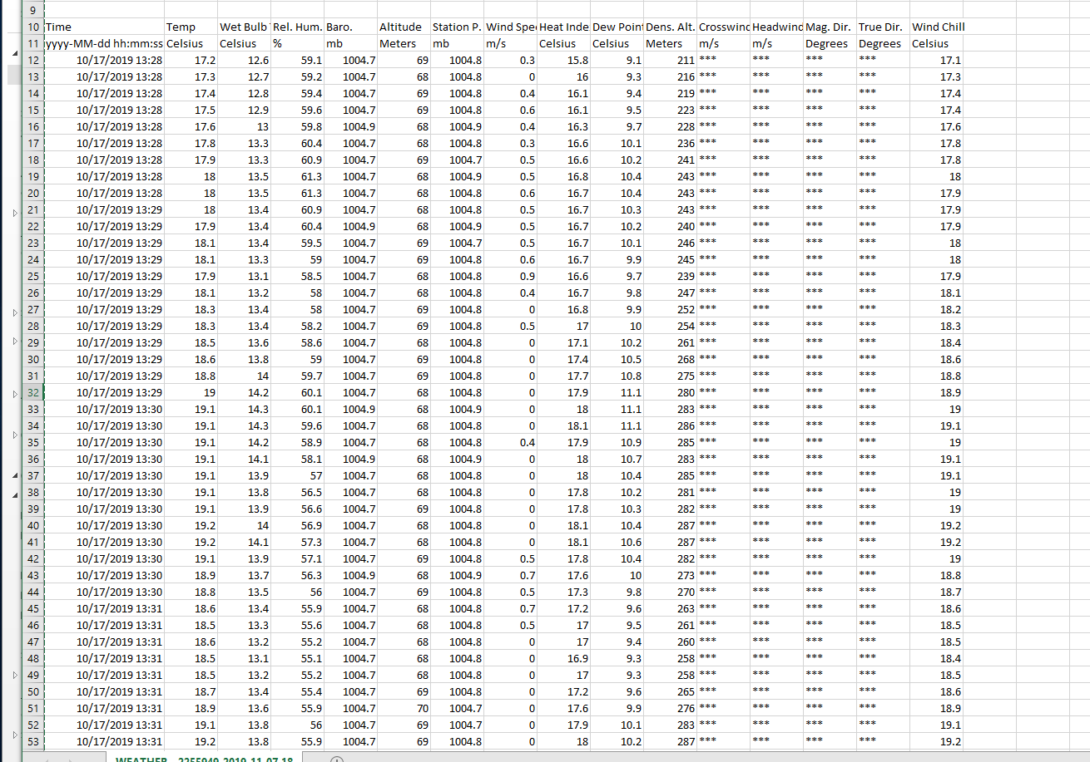
Typical Data from Kestrel Sensor

Slide 3
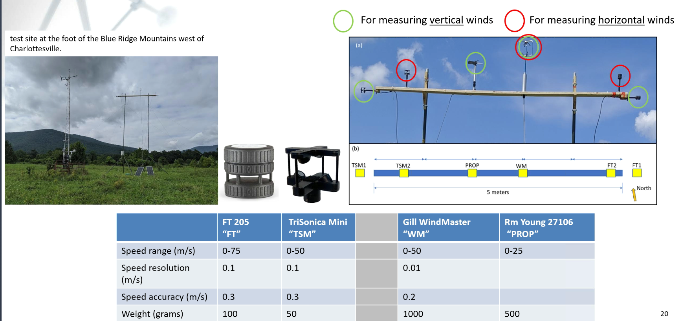
Other wind sensors of interest

Slide 4
Near-Term Objectives
Review the Kestrel Sensor features.
Gather FT100, Trisonica Mini, and Gill Windmaster sensor specifications
Compare and analyze the specifications especially in regard to SWaP (size, weight, and power consumption), data characteristics and ease of broadcasting/wireless RF link
Review UAV mounted wind sensors in the literature (Such as https://fttechnologies.com/wind-sensors/lightweight/)
Develop a scheme to mount the Kestrel and other sensors on a UAV platform to collect and transfer wind and other weather related data.

